Slide 1
Group 2
ETL Review

Slide 2
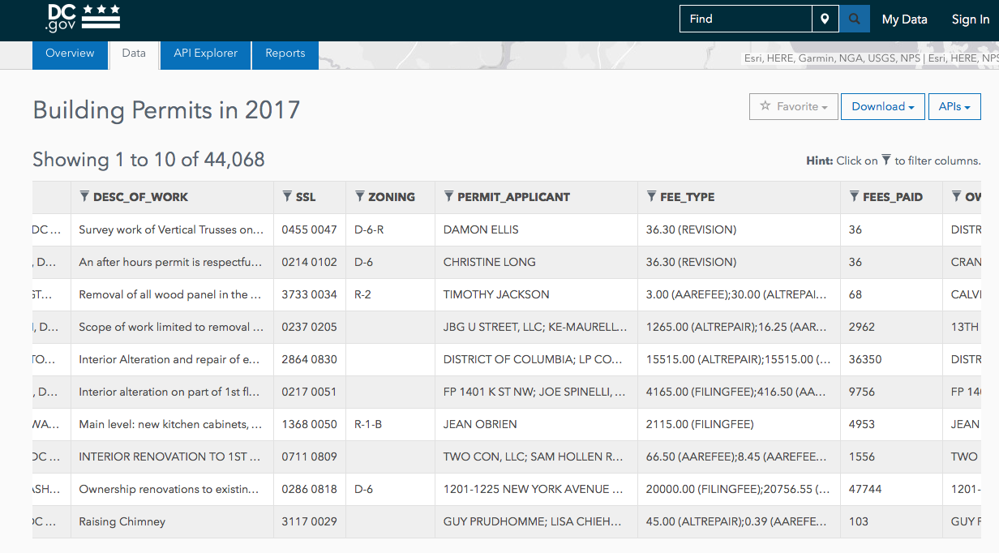
Dataset

Slide 3
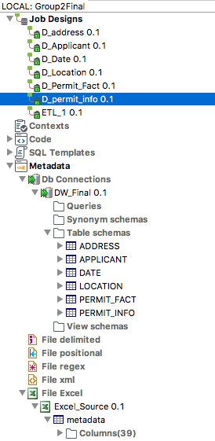
Schema

Slide 4

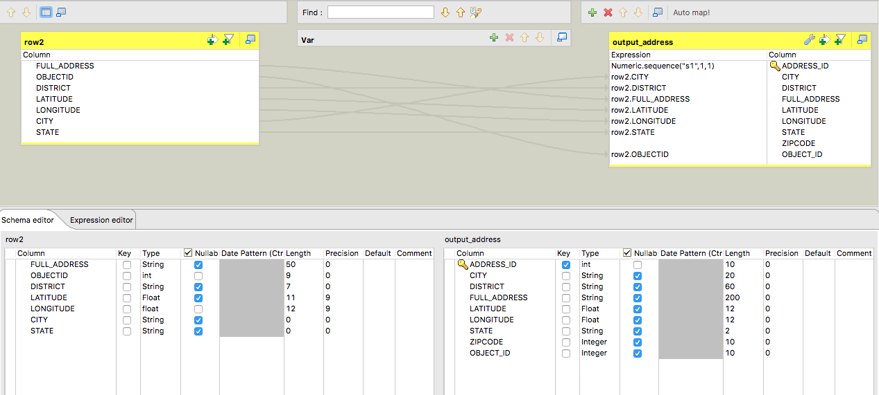
ETL: ADDRESS

Slide 5

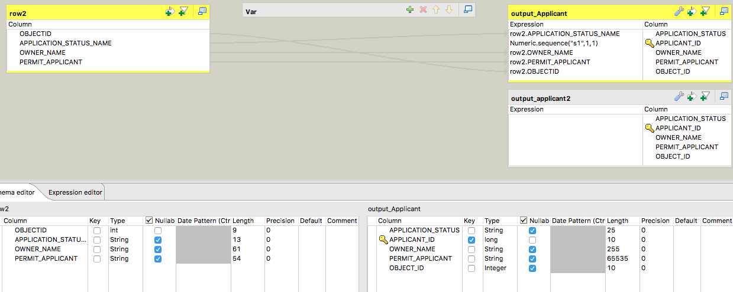
ETL: APPLICANT

Slide 6

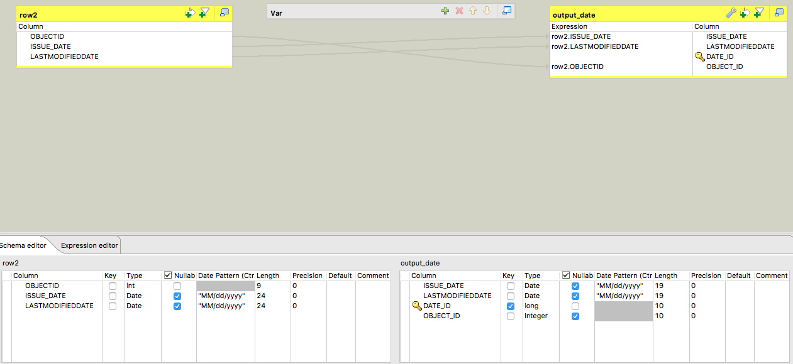
ETL: DATE

Slide 7

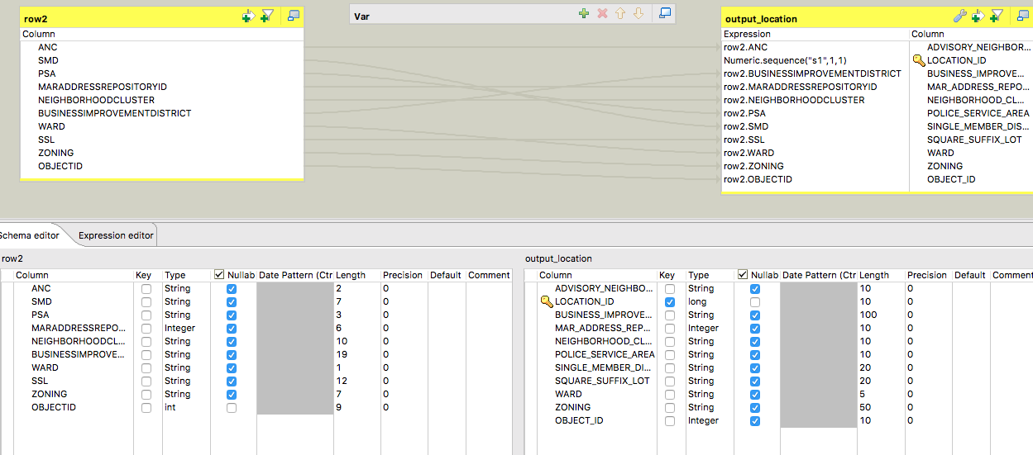
ETL: LOCATION

Slide 8

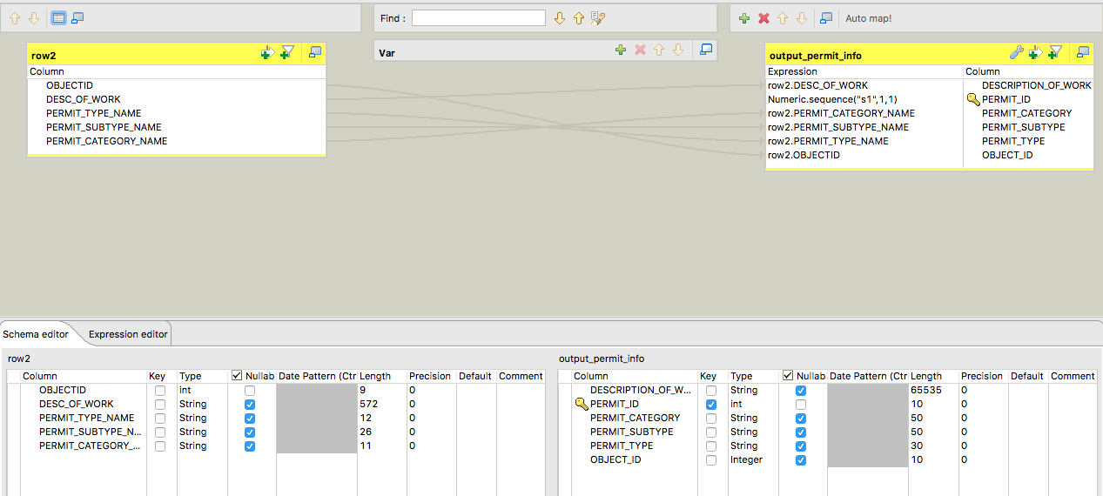
ETL: PERMIT_INFO

Slide 9
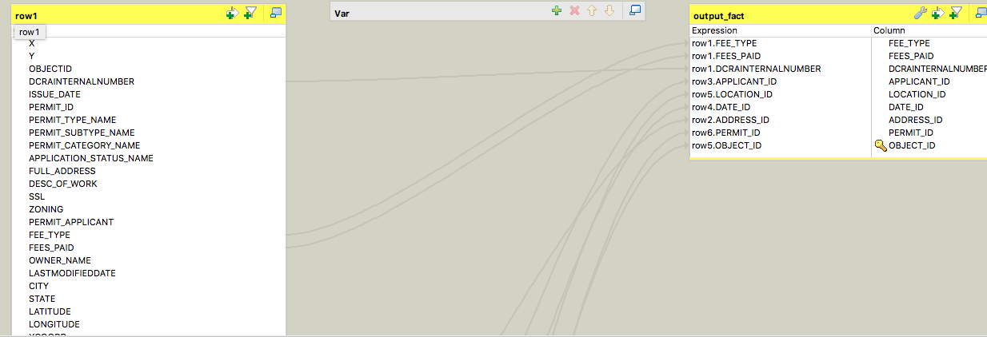
ETL: PERMIT_FACT

Slide 10
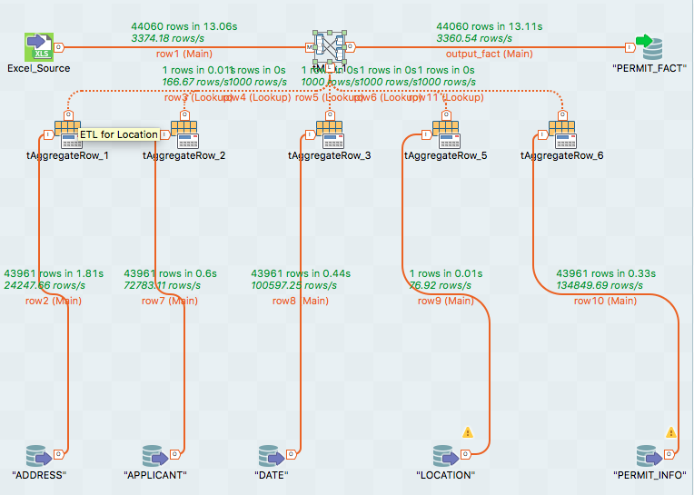
ETL: PERMIT_FACT (CONT’D)

Slide 11
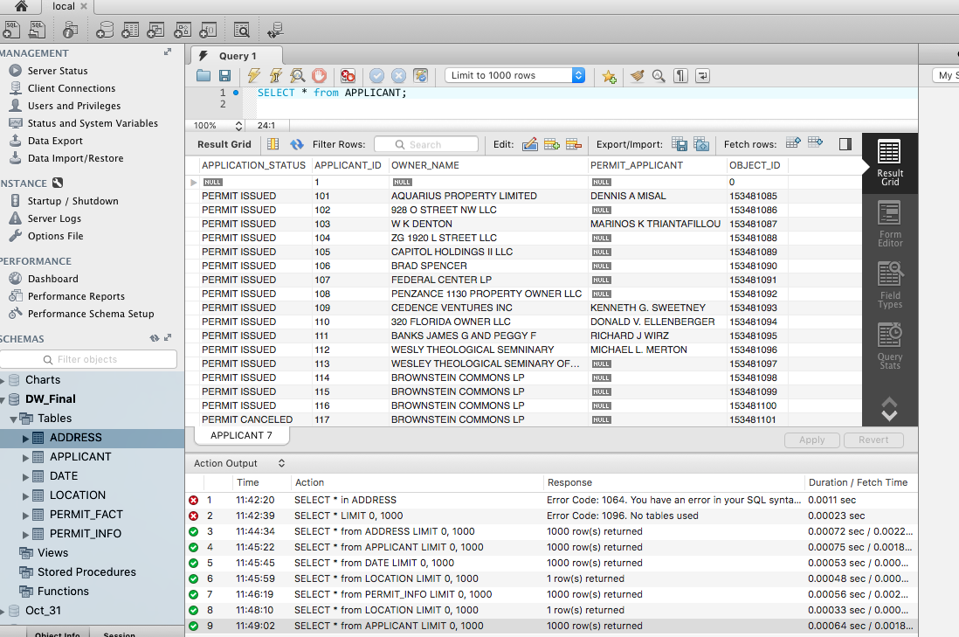
Test SQL Query

